Slide 1
Tapestry of Style
The How-To’s of Differentiating Between Pop and Classical and Everything in Between

Slide 2
If It Ain’t Broke…
Why mix it up?

Slide 3
Making It Sing
Familiar versus New hymns
Appropriate stylistic choices
Using choir or worship team to teach congregational singing
“Fun” in worship

Slide 4
Vocal Technique
The Fundamentals

Slide 5
Posture
Sitting position
Standing position
Chin Lift
Neck Position

Slide 6
Breath Management
Breathe as though you are a 360 degree person and go all the way around
More energetic styles of singing require more air which will make you sing louder

Slide 7
Tongue Position
This is the one fix that transformed my choir’s ability to lead congregational singing
Make sure that the tip of the tongue is touching the back of the bottom teeth at all times
When trying new styles, it’s important to remind your singers that they need to keep their tongues forward as they are changing the sound

Slide 8
Vocal Space
Many contemporary styles of singing require wide open mouth spaces.
Encourage your singers to open their mouths and allow their voices to come out
Trying to sing in certain styles without adequate vocal space will feel very uncomfortable

Slide 9
Vowels
Pure vowels are important in any context, no matter what the style
Vowel modification is an important tool to have in the singer’s tool kit
Knowing how to modify vowels will encourage your singers to approach new music with same robustness they approach old standards

Slide 10
Elements of Style
Vowel Modification
Rhythm
Use of Consonants
Articulation

Slide 11
“Traditional” Choral Style
Allowing familiar and comfortable to be okay

Slide 12
Traditional Elements
We teach:
Clear vowels
Rounded or vertical mouth shape
Head voice and Straight tone
Clean onset of sound
Clear direction of phrase and legato line
Rhythm is very accessible
Consonants (English) are very forward and easily timed together as a group

Slide 13
Let Us Ever Walk With Jesus 802

Slide 14
Swing
The easiest way in
Diction Modifications
Articulation Modifications
Vocal Space and Register

Slide 15
Diction Modifications
Closed vowels
Wet consonants often become soft or are dropped from the ends of words
Singing on consonants occasionally is encouraged
Consonants can be used as a percussive effect

Slide 16
Let Us Ever Walk With Jesus 802

Slide 17
Articulation Modifications
Rhythm
Division of the beat into three, especially on the eighth notes
Fat notes
Vocal Techniques
The fall
The shake
Brightness of tone
Scoops

Slide 18
Let Us Ever Walk With Jesus 802

Slide 19
Vocal Space and Register
Head voice vs Chest voice
Vocal Space in the upper register is huge which requires a large amount of air so your singers may not be able to sing gigantic phrases and may need to breathe more frequently

Slide 20
Let Us Ever Walk With Jesus 802

Slide 21
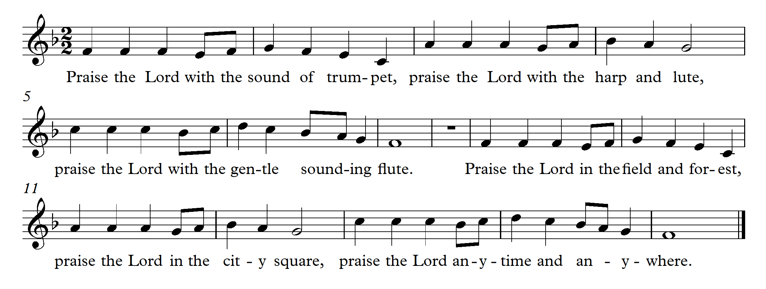
Praise the Lord

Slide 22
Pop
Jesus doesn’t necessarily have to be your boyfriend
Diction Modifications
Articulation Modifications
Vocal Space and Register

Slide 23
Diction Modification
Colloquialism of text
Spreading and Closing the vowel
Consonants

Slide 24
There Is Room For All

Slide 25
Articulation Modification
Accent on beats 1 and 3
Use of syncopation
Regular rhythm
The “noodle”

Slide 26
There Is Room For All

Slide 27
Vocal Space and Register
Energy of Tone – using the “belt” voice
Make sure your singers have adequate open space
Practice talking at pitch to find the belt sound
Predominance of chest voice

Slide 28
There Is Room For All

Slide 29
Go Make a Difference

Slide 30
Country
It’s more than old dogs and pick-up trucks.
Diction Modifications
Articulation Modifications

Slide 31
Diction Modification
Diphthongs
Sing on the second vowel, not the first
Vowel and Consonant modifications
“O” is often changed to “uh”
“T” often becomes “d”
“Ing” endings become “in’”
Singing on the consonants
“R” is not just for pirates
Singing on “M” and “N” for effect is fine
Slides and glides into notes are perfectly fine

Slide 32
Swing Low Sweet Chariot

Slide 33
Articulation Modification
Subtle emphasis on off-beats
Strong beat one
Vocal flips or breaks are completely acceptable
Regular rhythm

Slide 34
Swing Low Sweet Chariot

Slide 35
Precious Lord, Take My Hand

Slide 36
Gospel
Sing it, sister!
Diction Modifications
Articulation Modifications

Slide 37
Diction Modification
As with pop and swing, the vowels open to a slightly more spread modification and can close slightly through a moving passage
Consonants are “sloppy”
Often the text is repeated a number of times so the clarity of the diction is not as important
Slides and scoops are welcome additions

Slide 38
Just a Closer Walk With Thee

Slide 39
Articulation Modification
Quarter notes need to be “fat”
Improvisation with the melody is expected
Clapping on beats 2 and 4 is welcome and encouraged
Adding a slight sway with the body or a side to side motion with the feet is also fine

Slide 40
We Are One

Slide 41
Concluding Thoughts
It’s all about balance.

Slide 42
Everything in moderation.
Don’t be afraid!
Listen, always listen.
Use the choir or a soloist or a guest group or youth to introduce or encourage a new style of singing.
Variety is the spice of life.
Use style like salt – a little goes a long way. And some styles are like jalapeno peppers.

Slide 43
Questions?
kimdenis@hotmail.com

Slide 44
You Are Mine

